Slide 1
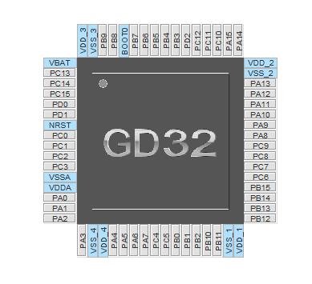
Battery switch
PAS (green?!)
DC/DC switch
CLK
Brake
LED
DIO
CAN Tx
OSCIn
CAN Rx
OSC0ut
Timer0 CH2
Timer0 CH1
Timer0 CH0
Hall C
ADC Battery voltage
Hall B
Hall A
Timer0 CH2 ON
ADC (Battery) Current
Timer0 CH1 ON
Timer0 CH0 ON
Timer0 BKIN
Speed
ADC Torque
ADC Throttle
ADC Battery voltage with offset

